Slide 1
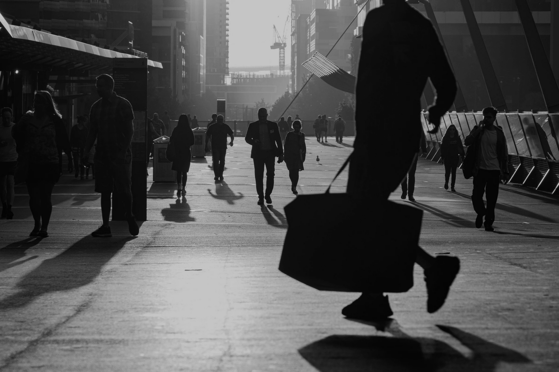
ANALYSIS ABSENTEEISM
ALEXANDER TAMAYO

Slide 2
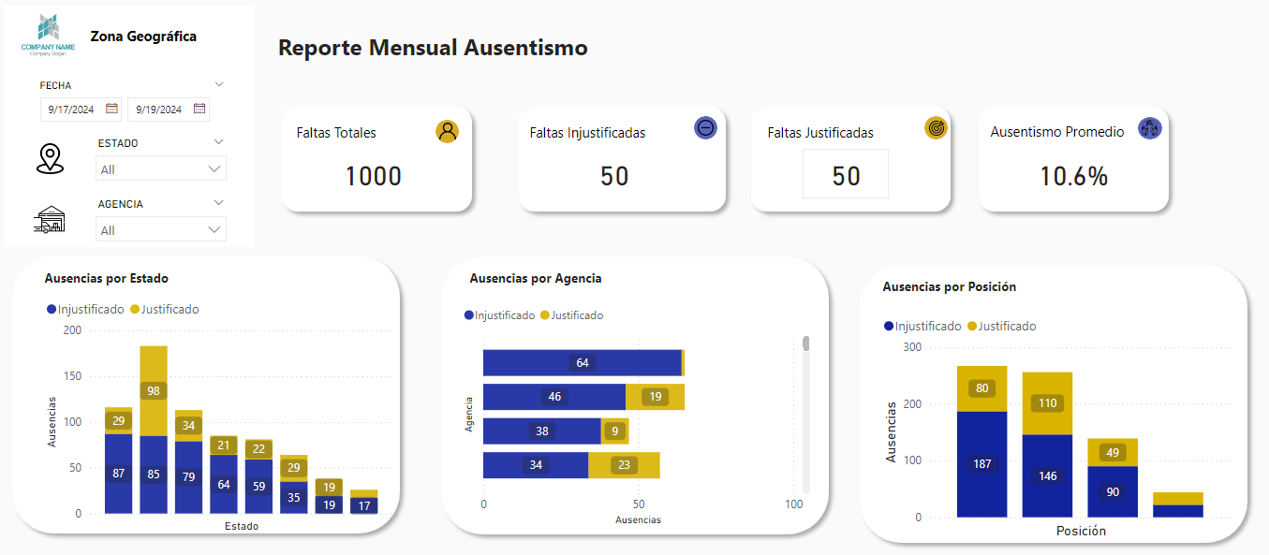

Slide 3
